Slide 2
The number of cameras just keeps growing
50bn
2025
27bn
2020
12bn
2015

Slide 3
Majority of crime goes undetected

Slide 4
Oddity helps focus on what matters

Slide 5
“Oddities” Roadmap
1
Violence
2020
2
Car crashes
2020
3
Vandalism
2021
4
Falling or fainting
2021

Slide 6
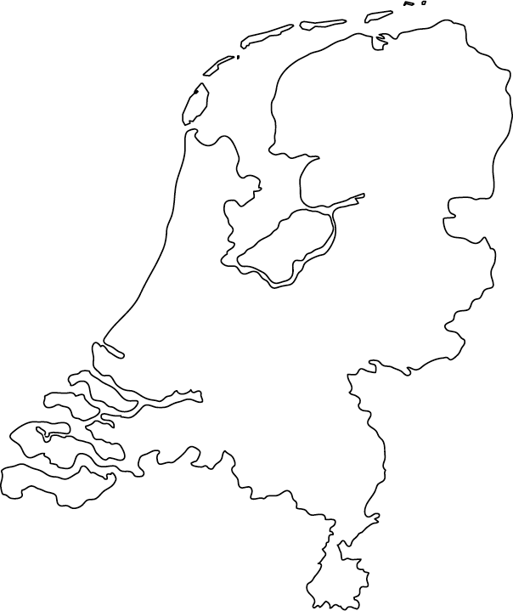
Customers
Working with Dutch Police Force
Live on >200 cameras
Software license per camera per year

Slide 7
Competition
Only European startup
GDPR compliant
No human or facial recognition
Extremely scalable solution

Slide 8
Partners

Slide 9
Infrastructure
Easy to implement with any Milestone system
In the cloud or on-premise

Slide 10
Founded by three entrepreneurs in 2018

Slide 11
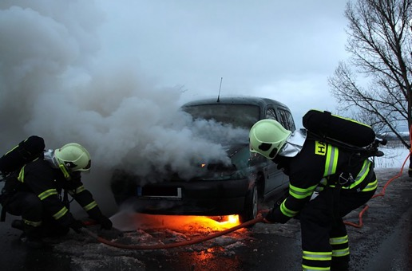
CAM 7: CAR CRASH
CAM 29: VIOLENCE
Unit 2
Unit 1

Slide 12
Future of Safety
Visit oddity.ai

