Slide 1

AXON / MILESTONE
Axon Incident Manager Plugin

Slide 2

DESIGN SPECIFICATIONS
COMPATIBILITY
XProtect Essentials
XProtect Express
XProtect Professional
XProtect Expert
XProtect Corporate
ARCHITECTURE
Product Name: Milestone Axon Export
Modules:
Axon Export Management Client
Axon Export Plug-In
Codec Pack Xvid-1.3.7-20191228.zip
Notes:
Centralized -> Leverage cloud-scalability to manage, transcribe, and redact in E.com
Centralized -> Securely share evidence with Prosecutors and Public Defenders using e-disclosure
Secure -> Enterprise-grade hardware provides reliability over DVD/DVR-based systems
Ease-of-Use -> Each instance customized per agency. No one deployment is the same.
Advanced Features -> Never miss a key moment with 24/7 Recording Buffer and Pre/Post Event Buffer
Advanced Features -> Designed for LEAs with features such as Secure Remote Viewing, Privacy Modes, and Chain-of-Custody Reporting

Slide 3
MILESTONE MANAGEMENT SERVER

Slide 4
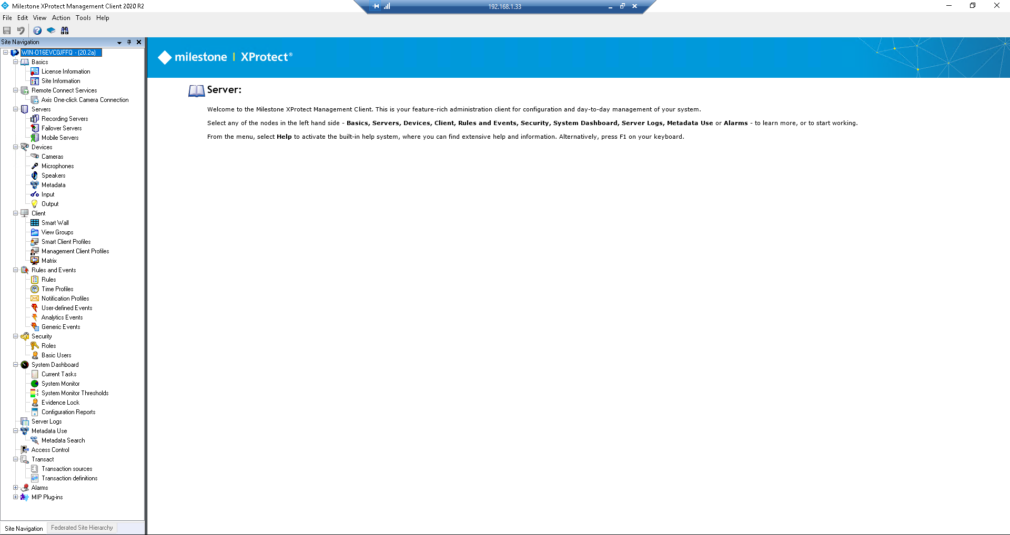
XPROTECT MANAGEMENT CLIENT

Slide 5
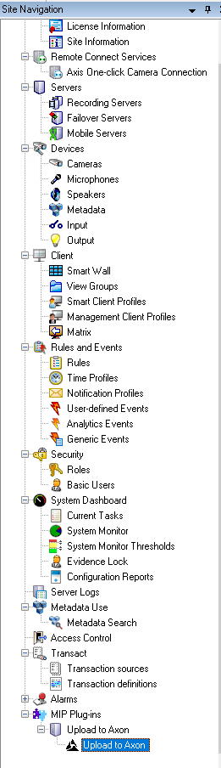
Axon Plugin in Management Server

Slide 6
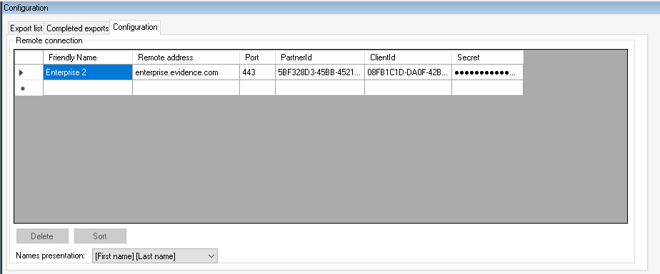
XPROTECT MANAGEMENT CLIENT
Can hold multiple instances of Evidence.com

Slide 7
CLIENT COMPUTER

Slide 8
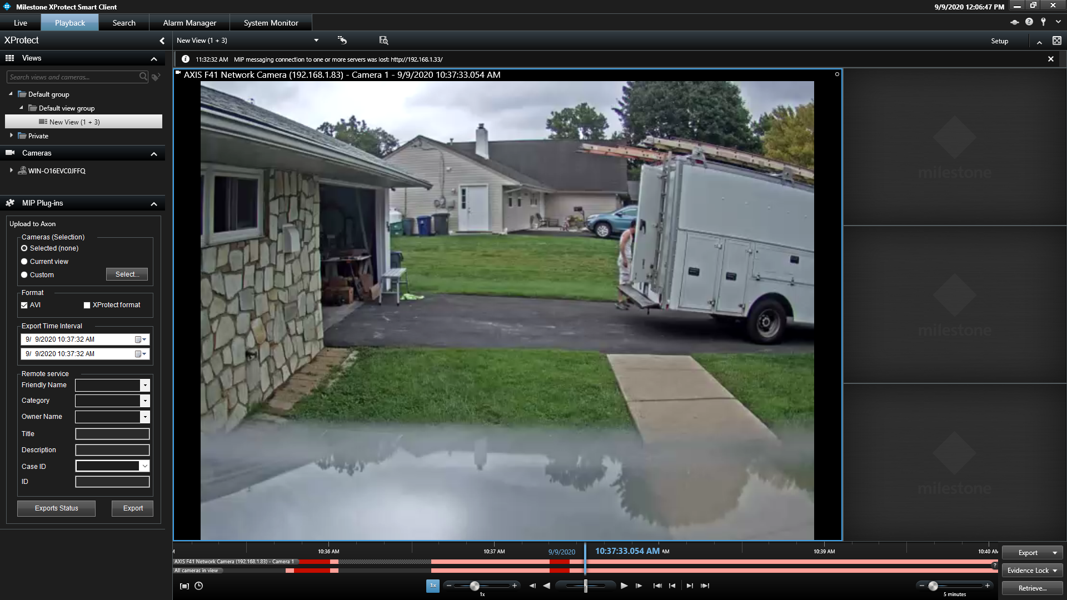
TRAY ICON CONFIGURATION

Slide 9
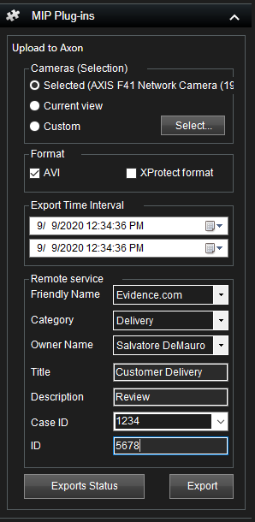
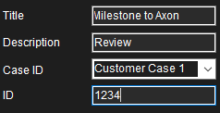
Can select a single, or multiplexed video based on view
Choice of format
Time Range
Metadata choices pull from Evidence.com
Will create case folder in Evidence.com and populate

Slide 10
AXON INCIDENT MANAGER
THE LEADING PLATFORM FOR THE DEMANDS OF MODERN INCIDENT MANAGEMENT

Slide 11
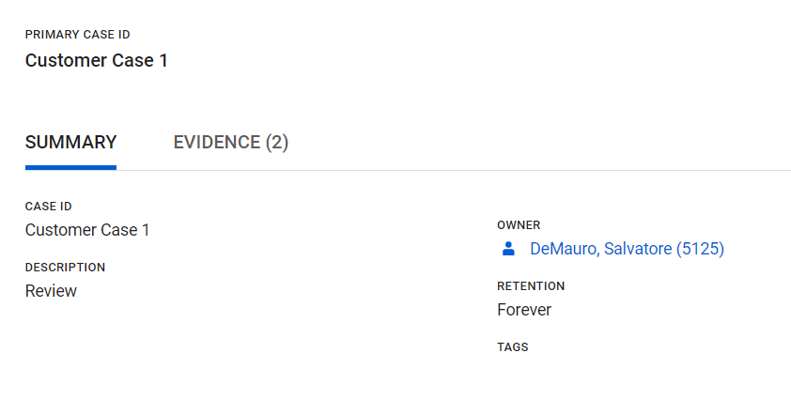
Case Created in Axon

Slide 12
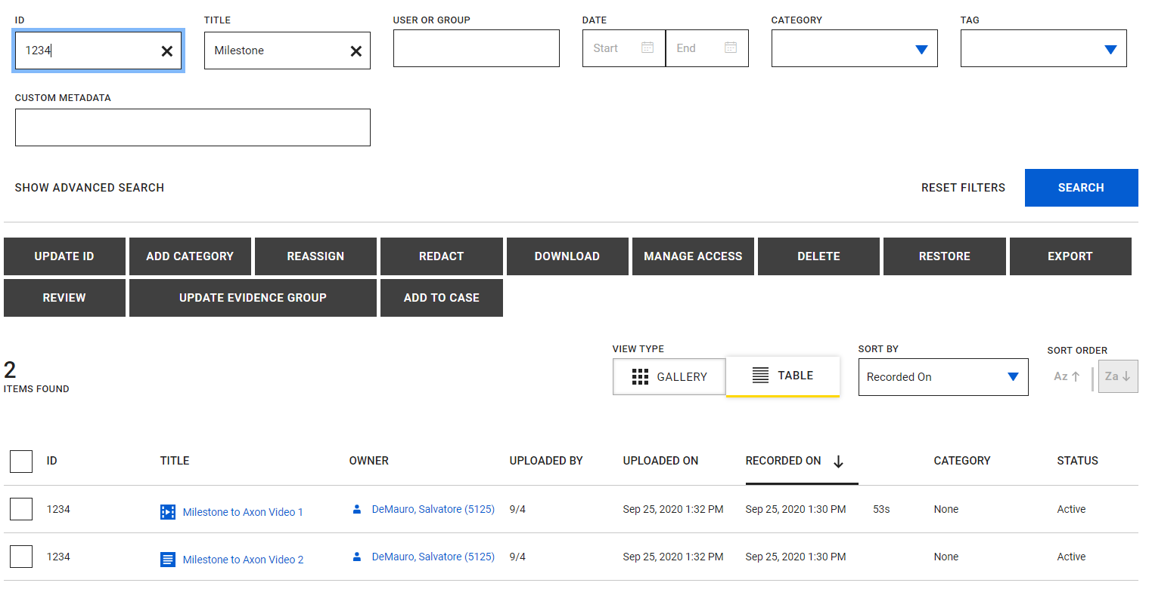
Assets Exist in the Axon Platform

Slide 13
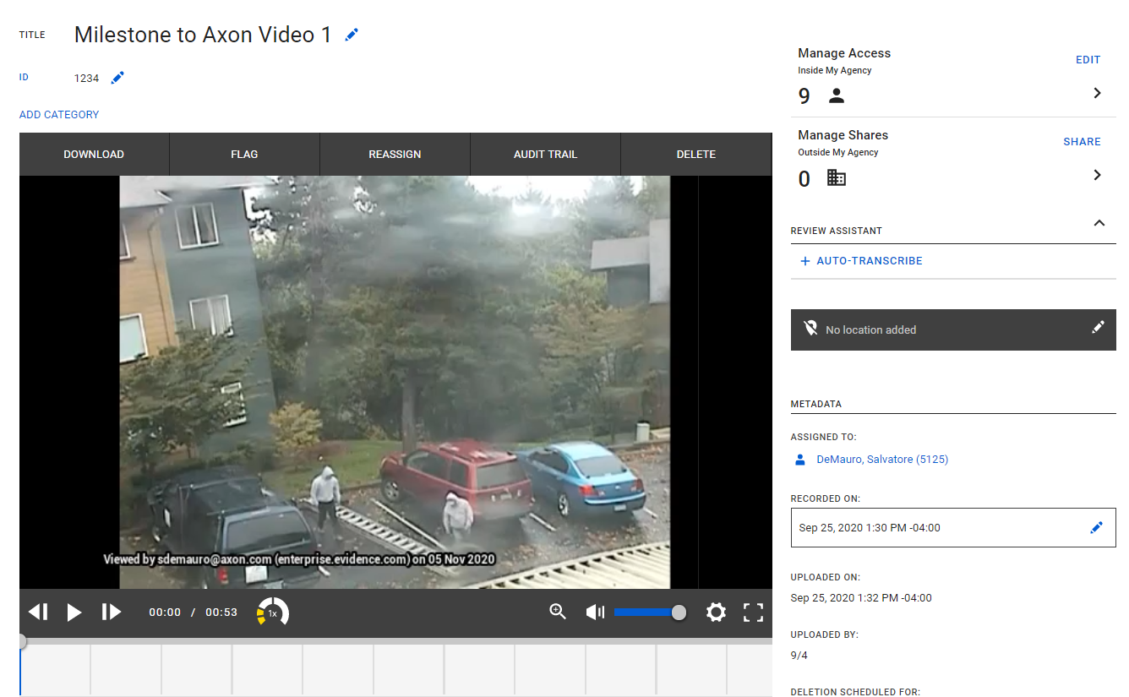
Video in Axon

Slide 14
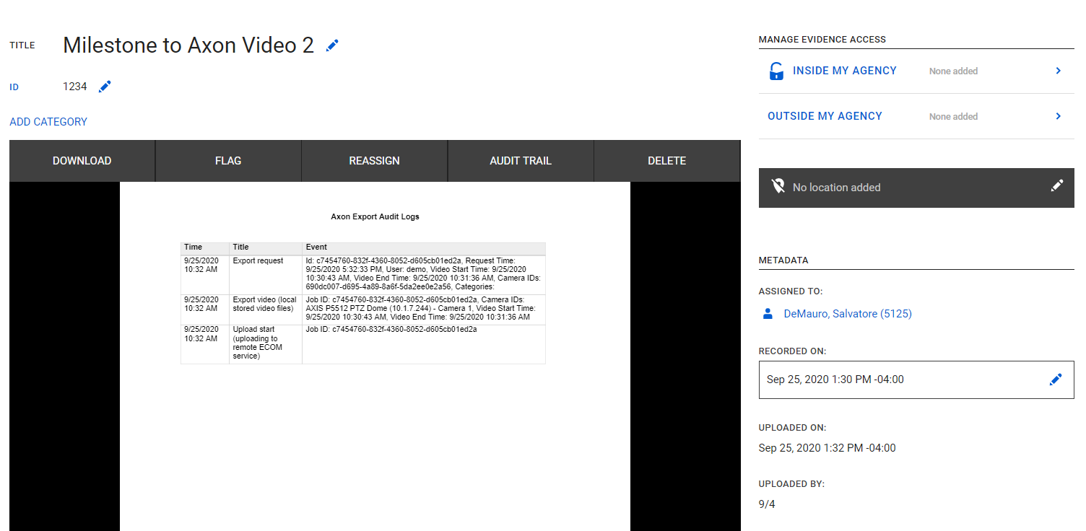
Milestone Audit Trail in Axon

